Slide 1
PROJECT 2 | EXPLORATORY DATA ANALYSIS
Optimal Funding Trajectories
for Follow-On Investment
A Data-Driven Seed-Stage Investment Thesis Built on Crunchbase Funding Data
Ohood Majed Ahmed Saleh · General Assembly DSI · Project 2 Presentation

Slide 2
INTRODUCTION & BACKGROUND
Every Startup Begins With a Bet
When a startup is founded, it typically raises a small seed round from angel investors or early-stage VCs to build an initial product and prove traction. The critical moment that follows is whether the company can go on to raise a follow-on round — Series A or later.
THE FUNNEL
Seed
Small early checks from angels
and seed-stage VCs
For a venture capital firm writing seed checks, correctly identifying which startups are most likely to progress is the difference between a portfolio that compounds in value — and one full of stalled, non-performing investments.
Follow-On (Series A+)
Signals the company hit real
milestones — worth continued investment
This analysis: ~54,000 Crunchbase companies
Optimal Funding Trajectories for Follow-On Investment
2

Slide 3
PROBLEM STATEMENT & GOALS
Most Seed Bets Never Pay Off
A venture capital firm struggles to reliably select seed-stage startups that will eventually secure follow-on funding — resulting in a portfolio of stalled companies. This analysis mines historical funding data to uncover the patterns that separate startups that progress from those that stall, in order to sharpen the firm's $10M seed-stage investment criteria.
BASELINE TO BEAT
13.4%
of seed-stage startups ever raise a follow-on round
KEY QUESTIONS
Which industries convert seed capital into follow-on rounds most often?
Does the size of the seed check itself predict future success?
Goal: build data-driven criteria that beat this baseline
Do geography and funding pace matter?
Optimal Funding Trajectories for Follow-On Investment
3

Slide 4
DATA & METHODOLOGY
Trustworthy Insights Start With Clean Data
1
2
3
4
Source
Scope
Cleaning
Cohort
Crunchbase startup funding dataset: company profiles, funding rounds, and amounts raised.
~54,000 companies worldwide, spanning industries, countries, and funding stages.
Removed blank/junk records, fixed data types, validated date logic, verified non-startup outliers by hand.
Defined the seed-stage cohort (seed/angel funding > 0) and a binary follow-on success flag.
Definition used throughout: a seed-stage company “succeeds” if it goes on to raise any Series A–H round.
Optimal Funding Trajectories for Follow-On Investment
4

Slide 5
ROADMAP
Five Lenses on Follow-On Success
01
Seed Check Size
Does the size of the first check predict what comes next?
02
Industry
Which sectors convert seed money into growth?
03
Geography
Where are the strongest follow-on ecosystems?
04
Funding Pace
How many rounds, and how much time, does progress take?
05
Interaction Effects
How do industry and check size combine?
Optimal Funding Trajectories for Follow-On Investment
5

Slide 6
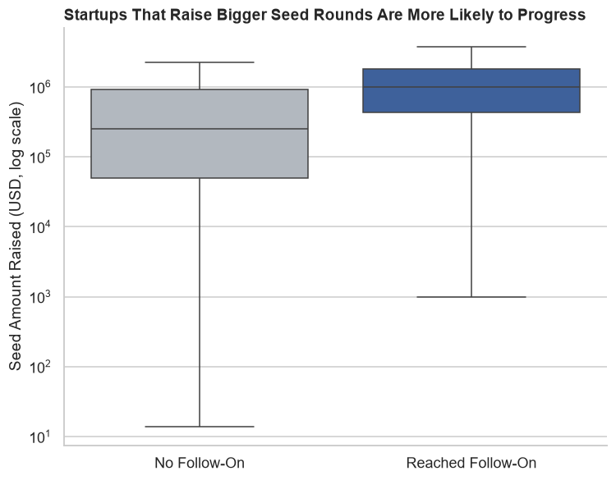
DEEP DIVE · 01 / 05
Bigger Seed Checks, Bigger Odds
$742K vs $150K
Median seed round for startups that reached follow-on funding, vs. those that didn't
Startups that eventually raised a follow-on round had a seed check nearly 5x larger than those that didn't — a highly significant difference (p < 0.001, Mann-Whitney U test). Seed check size is the single strongest signal found in this analysis.
Optimal Funding Trajectories for Follow-On Investment
6

Slide 7
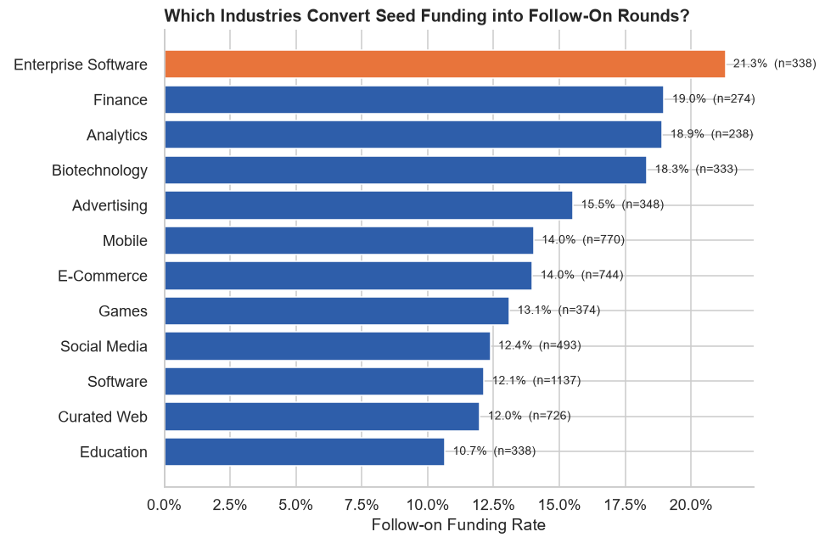
DEEP DIVE · 02 / 05
Not All Industries Are Created Equal
TOP CONVERTERS
Enterprise Software, Finance,
Analytics & Biotechnology
convert seed funding into follow-on rounds at roughly 1.5–2x the rate of categories like Education or Curated Web — a statistically significant pattern (Chi-square, p < 0.001).
This directly informs where the firm's $10M thesis should concentrate.
Optimal Funding Trajectories for Follow-On Investment
7

Slide 8
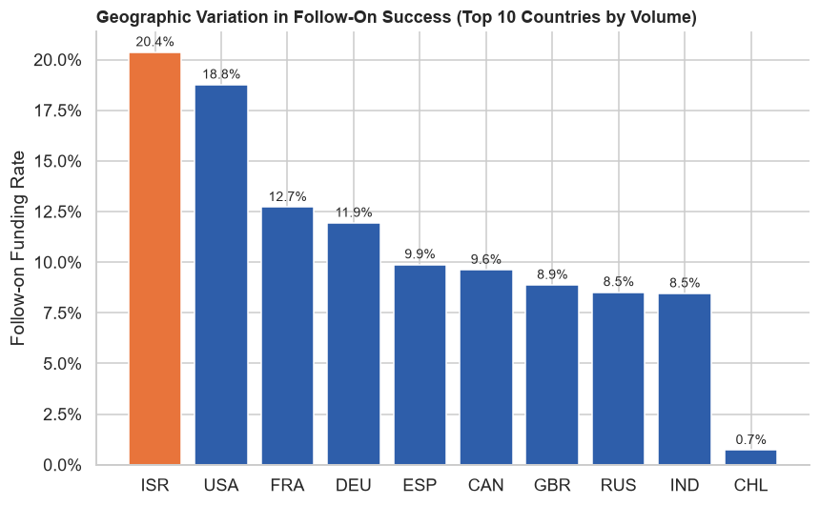
DEEP DIVE · 03 / 05
Location Shapes the Odds
20.4%
Israel's follow-on rate — the highest of any major hub
The USA (18.8%) and Israel substantially outperform other hubs, likely reflecting deeper, more mature Series-A investor networks (Chi-square, p < 0.001).
Optimal Funding Trajectories for Follow-On Investment
8

Slide 9
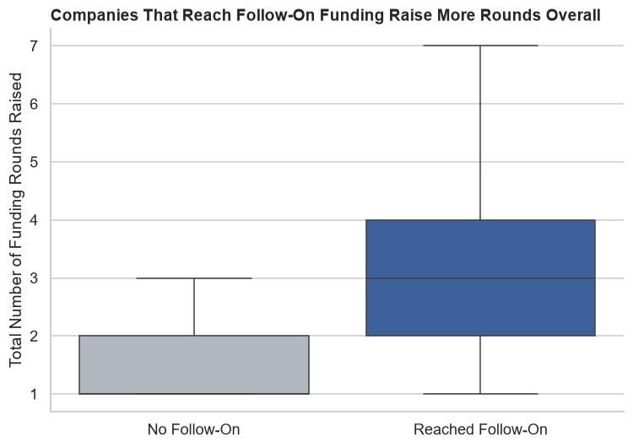
DEEP DIVE · 04 / 05
Progress Takes Rounds — and Time
Companies that reach follow-on funding raise more rounds overall (median of 3 vs. 1), and the typical gap between a startup's seed round and its most recent round is about:
768 days
~2.1 years — the benchmark checkpoint for flagging a stalled investment
Meanwhile, how quickly a startup closes its first round after founding shows no significant relationship with follow-on success (p = 0.23) — a useful negative finding.
Optimal Funding Trajectories for Follow-On Investment
9

Slide 10
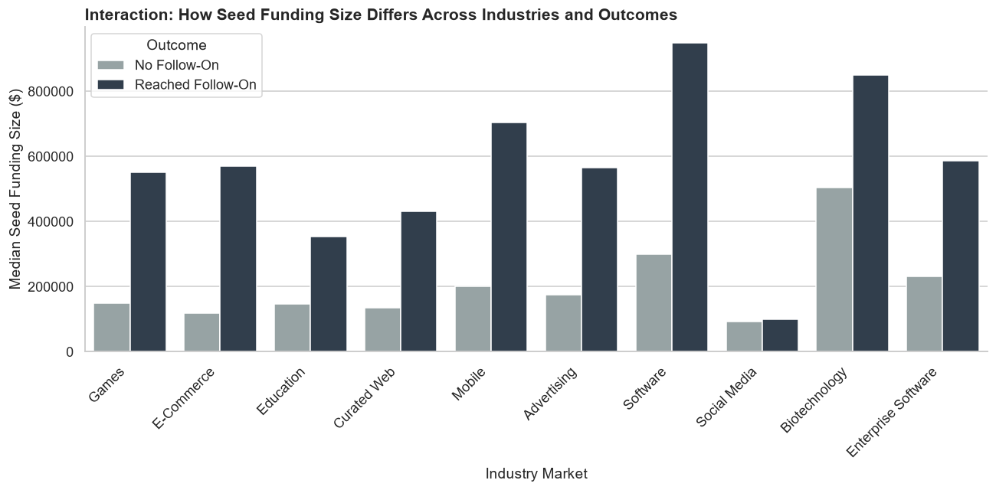
DEEP DIVE · 05 / 05
Check Size Matters Inside Every Industry
Across nearly every top industry, startups that reached follow-on funding raised a larger median seed check than those that stalled — confirming check size is a cross-sector engine, not just a one-industry effect.
Optimal Funding Trajectories for Follow-On Investment
10

Slide 11
SUMMARY OF FINDINGS
What the Data Told Us
Seed check size
Strongest predictor — 5x larger for companies that progressed
Industry
Enterprise Software, Fintech, Analytics & Biotech lead by 1.5–2x
Geography
USA and Israel substantially outperform other hubs
Timeline
~768 days is the typical seed-to-latest-round window
Speed to first funding
No significant effect — safe to ignore in criteria
Optimal Funding Trajectories for Follow-On Investment
11

Slide 12
RECOMMENDATIONS & NEXT STEPS
Turning Data Into a $10M Thesis
1
Prioritize Enterprise Software, Fintech, Analytics & Biotechnology startups
2
Favor larger seed checks — at or above the ~$742K historical median for success
3
Set an 18–24 month post-seed checkpoint to flag stalled investments early
4
Weight US and Israel-based teams more favorably, without excluding other regions
5
Do not penalize startups for a slower first raise — it isn't predictive
Next steps: this analysis is correlational and the dataset runs through ~2014 — validate against more recent funding data, and consider a causal study before finalizing investment criteria.
Thank you
Optimal Funding Trajectories for Follow-On Investment
12

